Slide 1

CSE 163
Classes and Objects
Hunter Schafer

Slide 2
Last time on...

Slide 3
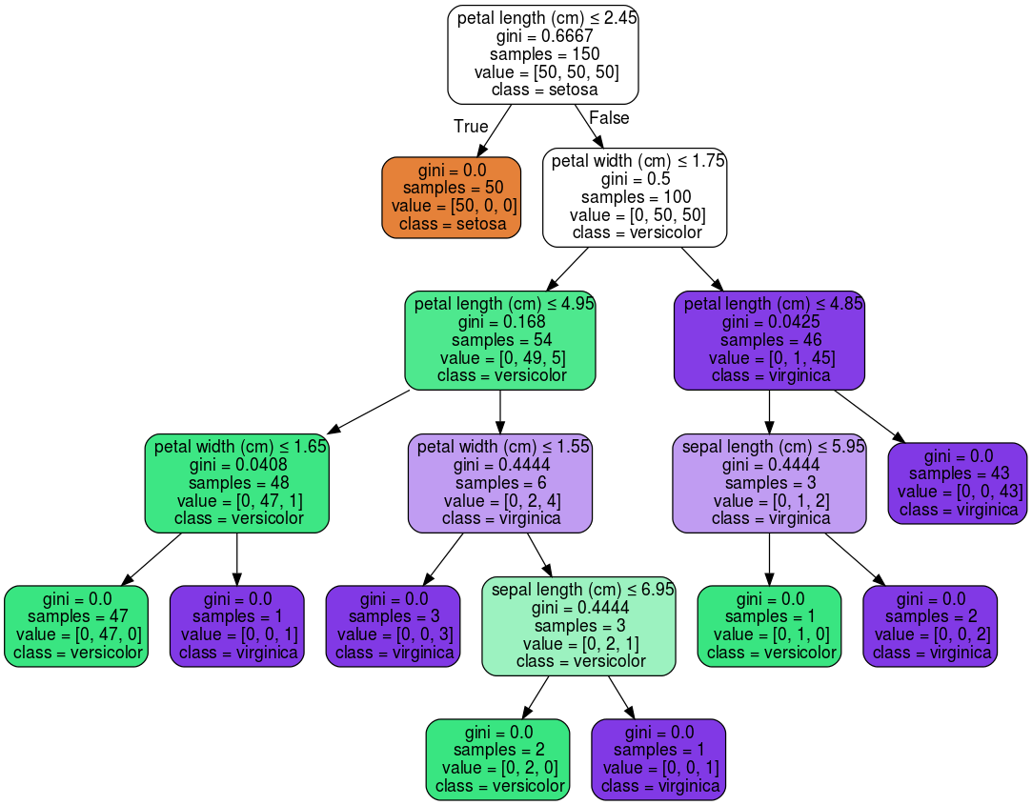
Decision Tree

Slide 4
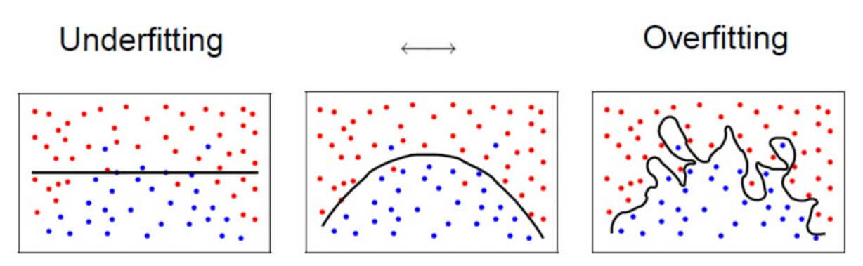
Overfitting
The most important problem in science you’ve never heard of
Overfitting: When your model matches the training set so well, that it fails to generalize
Memorizing answers to Multiple Choice test
Tall trees are likely to overfit if you don’t have enough data
Can learn very complex boundaries
Very few points at the leaves

Slide 5
Evaluating Models
Training is cool, but we want to know its future performance
Training data can’t be used to evaluate model
“I got 100% on the practice test I have been studying for 4 hours, therefore I will get 100% on the exam”
Must hold out data called a test set to evaluate at the end
Unbiased estimate of performance in the wild
Never ever ever train or make decisions based on your test set.
If you do, it will no longer be good estimate of future performance.

Slide 6
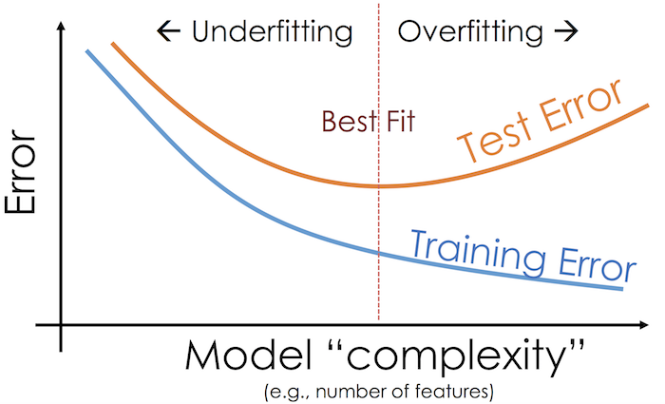
Model Complexity
Note this is error, not accuracy (error = 1 - accuracy)

Slide 7
This week!

Slide 8
Objects
An object holds state and provides behaviors that operates on that state
Each object has its own state
Example: DataFrame
df1 = pd.DataFrame({'a': [1, 2, 3]})
df2 = pd.DataFrame({'a': [1, 2, 3]})
 | a
0 | 1
1 | 2
2 | 3
 | a
0 | 1
1 | 2
2 | 3
df1
df2

Slide 9
DataFrame
State
The columns
The index
The actual data
Etc.
Behaviors
Methods for providing access to the data
Methods to modify data
Methods to find/replace missing values
Etc.

Slide 10
Class
A class lets you define a new object type by specifying what state and behaviors it has
A class is a blueprint that we use to construct instances of the object
Here is a full class
class Dog:
def __init__(self, name):
self.name = name
def bark(self):
print(self.name + ': Woof')
A class definition
An initializer that sets fields (state)
A method (behavior)

Slide 11
Building Dogs
d1 = Dog('Chester')
d2 = Dog('Scout')
d3 = d1
d1.bark()
d2.bark()
d3.bark()
# Chester: Woof
# Scout: Woof
# Chester: Woof
d1
name: 'Chester'
d2
name: 'Scout'
d3

Slide 12
Note to Self
In the Dog example, every method (initializer or otherwise) takes a parameter called “self”
This indicates which instance the method is being called on
On the first line, self references Chester
On the second line, self references Scout
On the third line, self references Chester
class Dog:
def __init__(self, name):
self.name = name
def bark(self):
print(self.name + ': Woof')
d1.bark() d2.bark() d3.bark()

Slide 13
Coding with Classes
VS Code
Can split program into multiple files
Put the Dog class in dog.py
# Syntax 1
import dog
d = dog.Dog('Chester')
# Syntax 2
from dog import Dog
d = Dog('Chester')

Slide 14
1 minute
For this program, draw the memory model for the objects and then select which option best represents your model.
d1 = Dog('Chester')
d2 = Dog('Scout')
d3 = d1
p1 = DogPack()
p1.add_dog(d1)
p1.add_dog(d2)
p2 = DogPack()
p2.add_dog(d3)

Slide 15
2 minutes
For this program, draw the memory model for the objects and then select which option best represents your model.
d1 = Dog('Chester')
d2 = Dog('Scout')
d3 = d1
p1 = DogPack()
p1.add_dog(d1)
p1.add_dog(d2)
p2 = DogPack()
p2.add_dog(d3)

Slide 16
Not a real slide
p1
DogPack
dogs:
[ , ]
Dog
name: 'Chester'
Dog
name: 'Scout'
p2
DogPack
dogs:
Dog
name: 'Chester'
[ ]

Slide 17
Not a real slide
p1
DogPack
dogs:
[ , ]
Dog
name: 'Chester'
p2
Dog
name: 'Scout'
DogPack
dogs:
[ ]

Slide 18
Nota real slide
DogPack
dogs:
Dog
name: 'Chester'
[ , ]
Dog
name: 'Scout'
p1
DogPack
dogs:
Dog
name: 'Chester'
[ ]
p2

Slide 19
Private
Objects are great, but it’s not desirable if the client can change our state without us “knowing” about it
It would be nice if we could restrict the client to just using the behaviors we provide
p = DockPack()
p.add_dog(Dog('Chester'))
p.dogs = None
p.add_dog(Dog('Scoute')) # Crashes

Slide 20
Private
Python has no way to actually do this, but by convention people don’t access things that start with “_”
class DogPack:
def __init__(self):
self._dogs = []
def add_dog(self, dog):
self._dogs.append(dog)
def _private_method(self):
print('Some helper method')

